Slide 1

YouTube Analytics from Nov 2017-Jun 2018 in the U.S.
Joshlyn Jamerson, YJ Kim, Robert Auer, Travis Lindeman

Slide 2
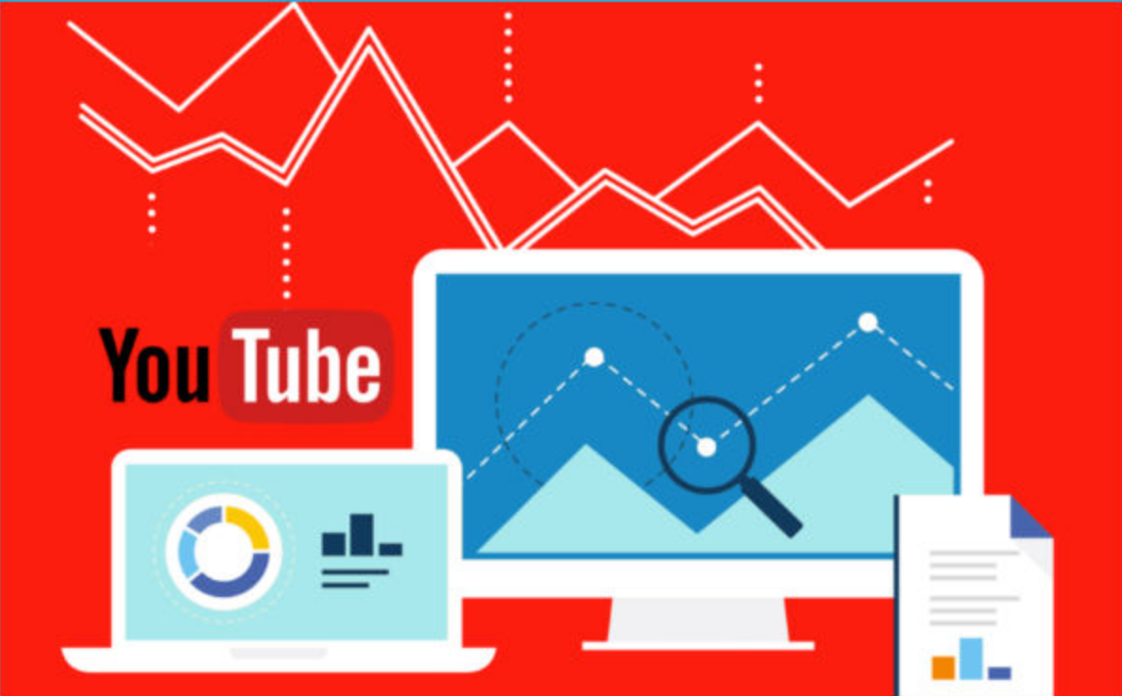
Stakeholder Interest
Analyzing YouTube viewership
Evaluating audience engagement
Informing marketing decisions
Notes:
Analyzing YouTube video viewership is important for evaluating content performance, understanding the audience, optimizing content, monetization, competitor analysis, and making informed decisions. It helps creators and businesses maximize their reach, engagement, and overall success on the platform.

Slide 3
Agenda
Most popular content creators
Analysis by video category
Most viewed
Most commented
Timeline between publication and trending status

Slide 4
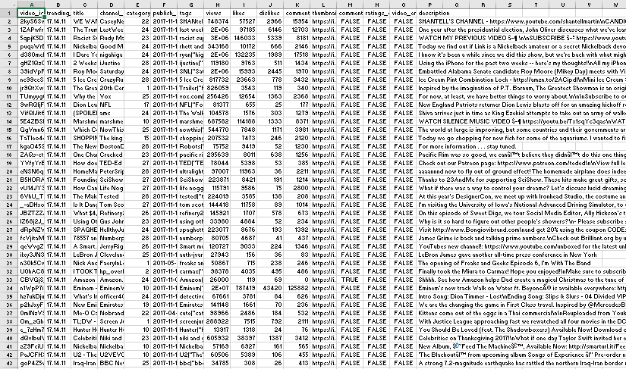
Data of Interest
Channel name
Trending date
Publish time
Views
Comment count
Video Id

Slide 5
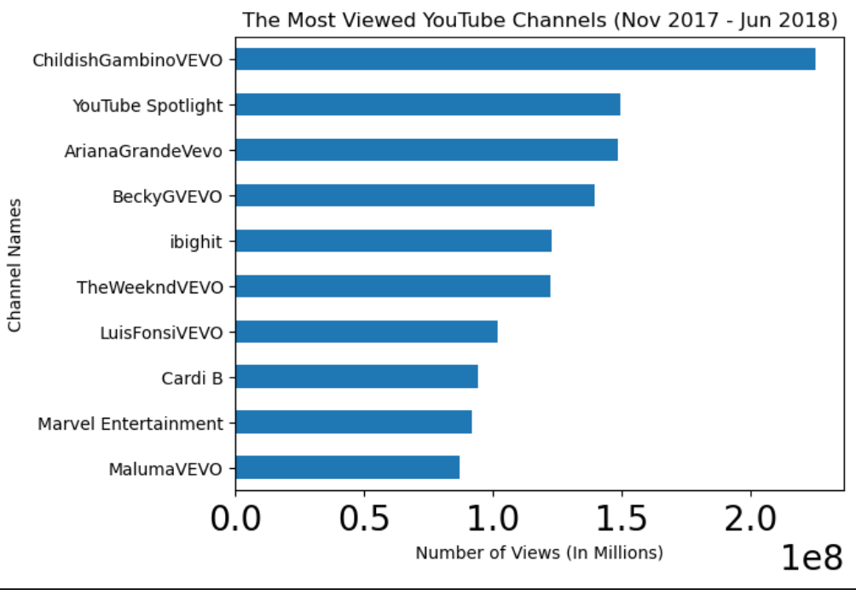
Notes:
Our analysis determined the top ten most viewed YouTube channels which can be used to target an advertising campaign.

Slide 6
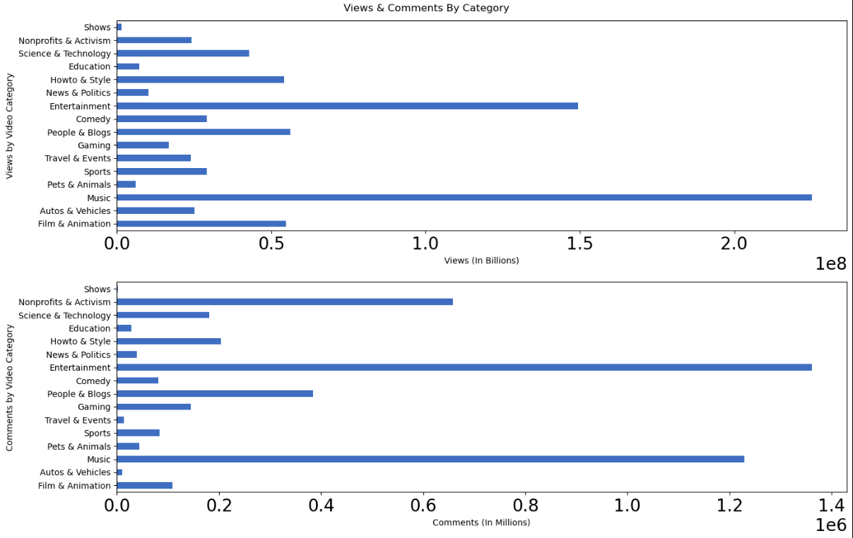
Notes:
Our analysis of the data can inform building advertising campaigns. We can demonstrate that to get the most visibility campaigns should seek to attach ads to ‘entertainment’ and ‘music’ videos due to their receiving 10x as many views as categories like ‘news & politics’ and ‘travel & events.’ Of note, while music videos receive the most views, viewers are most engaged with entertainment videos.

Slide 7
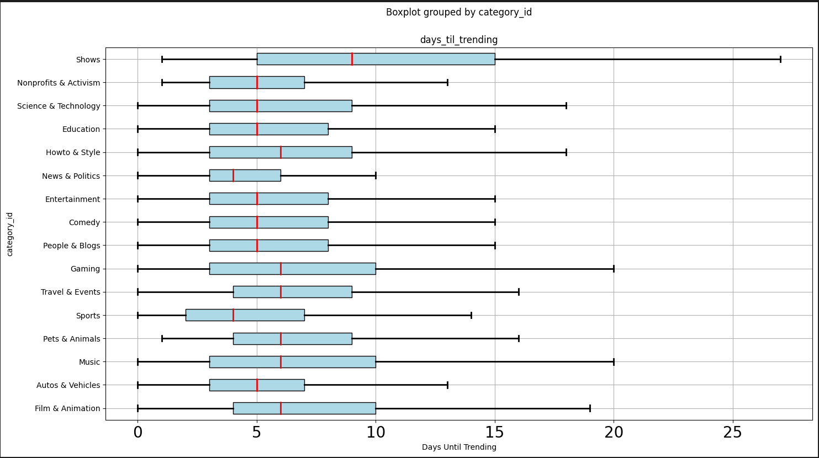
Notes:
Days til Trending shows that most categories of videos reach trending threshold with an average of five days from publication. This data can help inform the duration of an ad campaign.

Slide 8
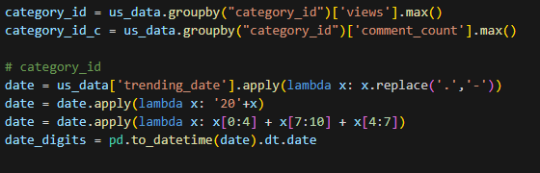
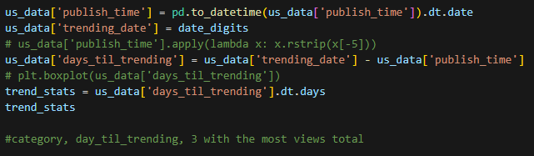
Data Cleaning
Duplicate data
Time formatting consistency
Converting time to integers
Date/time formatting
Removing outliers
Visual clarity on category ids
(Converting to the consistent date/time format)
(Removing outliers from trending videos)

Slide 9
Future Project Plans
Trending tags, identifying what makes a video trend
Duration of trending content
Identifying social media platforms in descriptions

Slide 10
Q&A
Teammates contact info
Link to repository
Link to dataset

